Slide 1

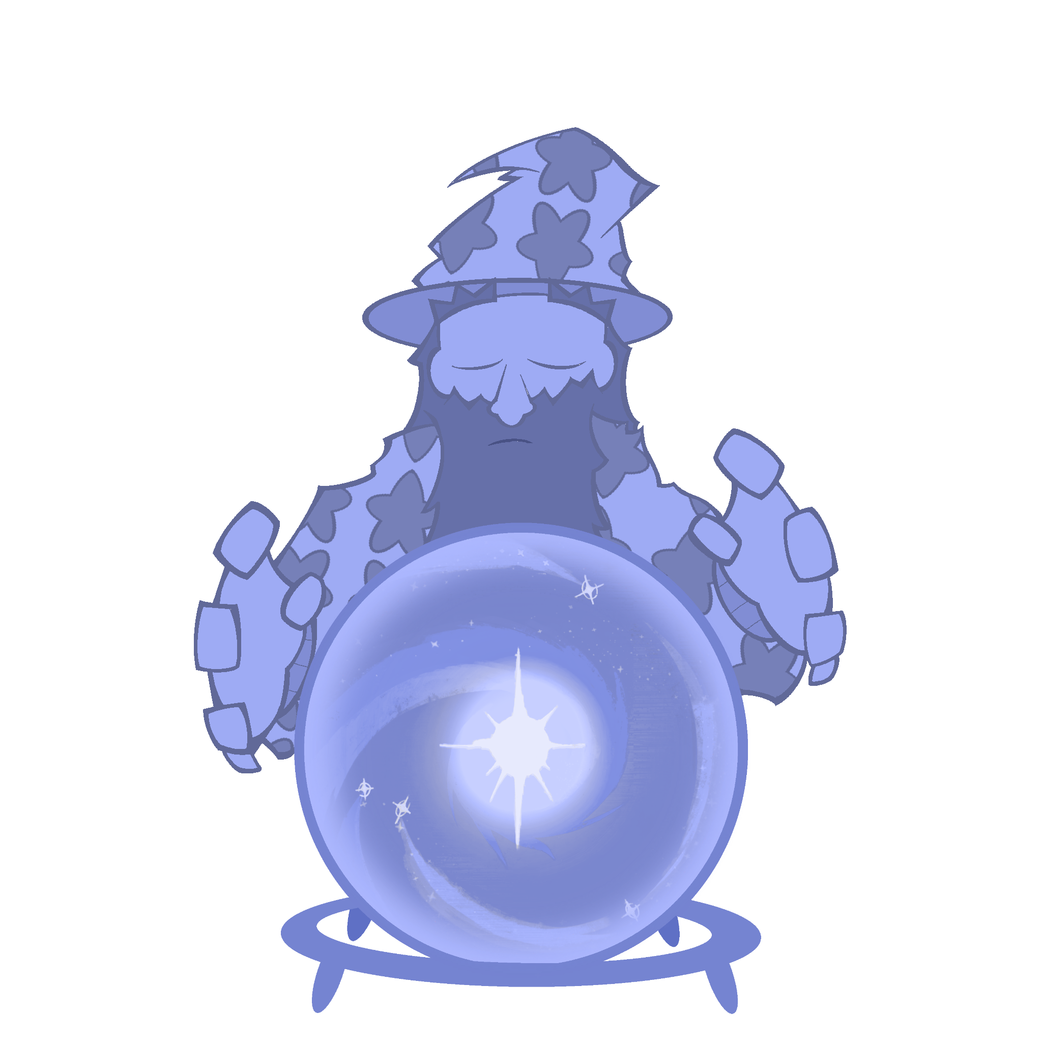

WIZE WIZARD

Slide 2

Introduction
Wize Wizard Team
Ivy - Project Manager
Xeno - Design Lead
Liam - Content Lead
Problem we’re solving:
Assist older generations with navigating technology
Keeping them with family/friends in struggles
Streamline searching process for simple tasks
Notes:
While we shared many roles, our team consisted of Me, Liam, and Ivy.
Me being the design lead, Ivy being the project manager,
and Liam being the content lead.
The other unlisted roles (Research Lead, Usability Tester, Prototype Developer)
had their responsibilities split up evenly between us. Our target audience were those that were less tech savvy, specifically
the elderly, as they would rely on this app to more conveniently search things on the internet.
A frequent user of the app would be the middle aged, more adept at navigating the internet than the elderly
but would still most likely need assistance from Wize Wizard for more complex tasks.
Meanwhile the younger generation are casual users of the app, employing the help of Wize Wizard for convenience sake

Slide 3
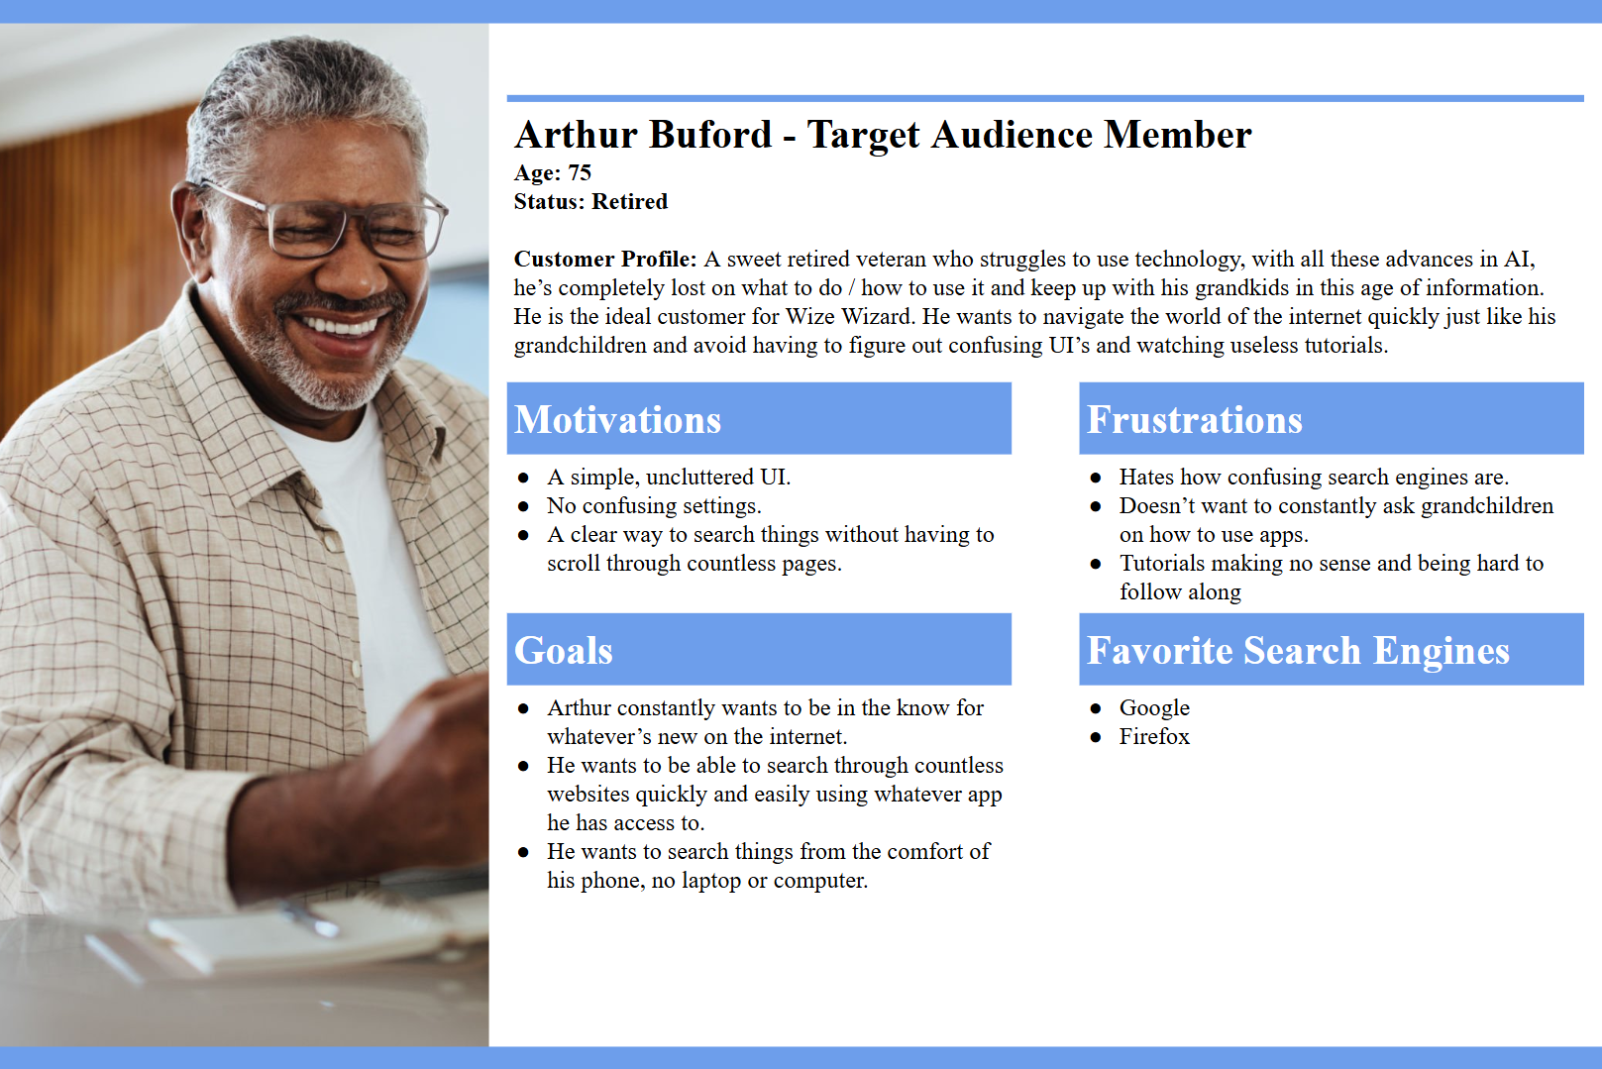
“Ideal” User
Notes:
This is what we thought our “ideal user” would be.
From an older generation
Struggles to use modern technology
Aiming to be self sufficient

Slide 4
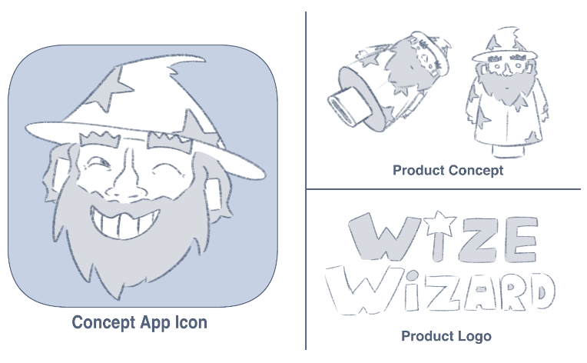
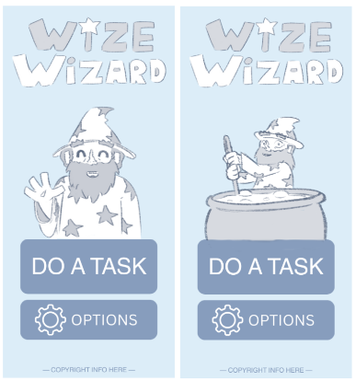
Original Proposal
Notes:
What really spoke to our team was the soft artstyle found in the original proposal of Wize Wizard!

Slide 5
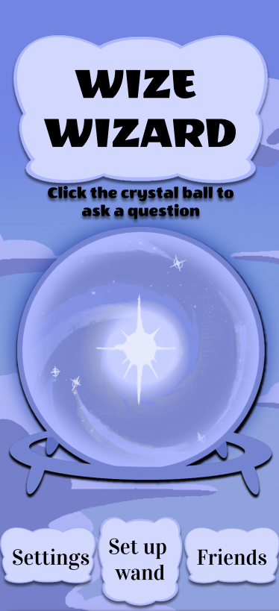
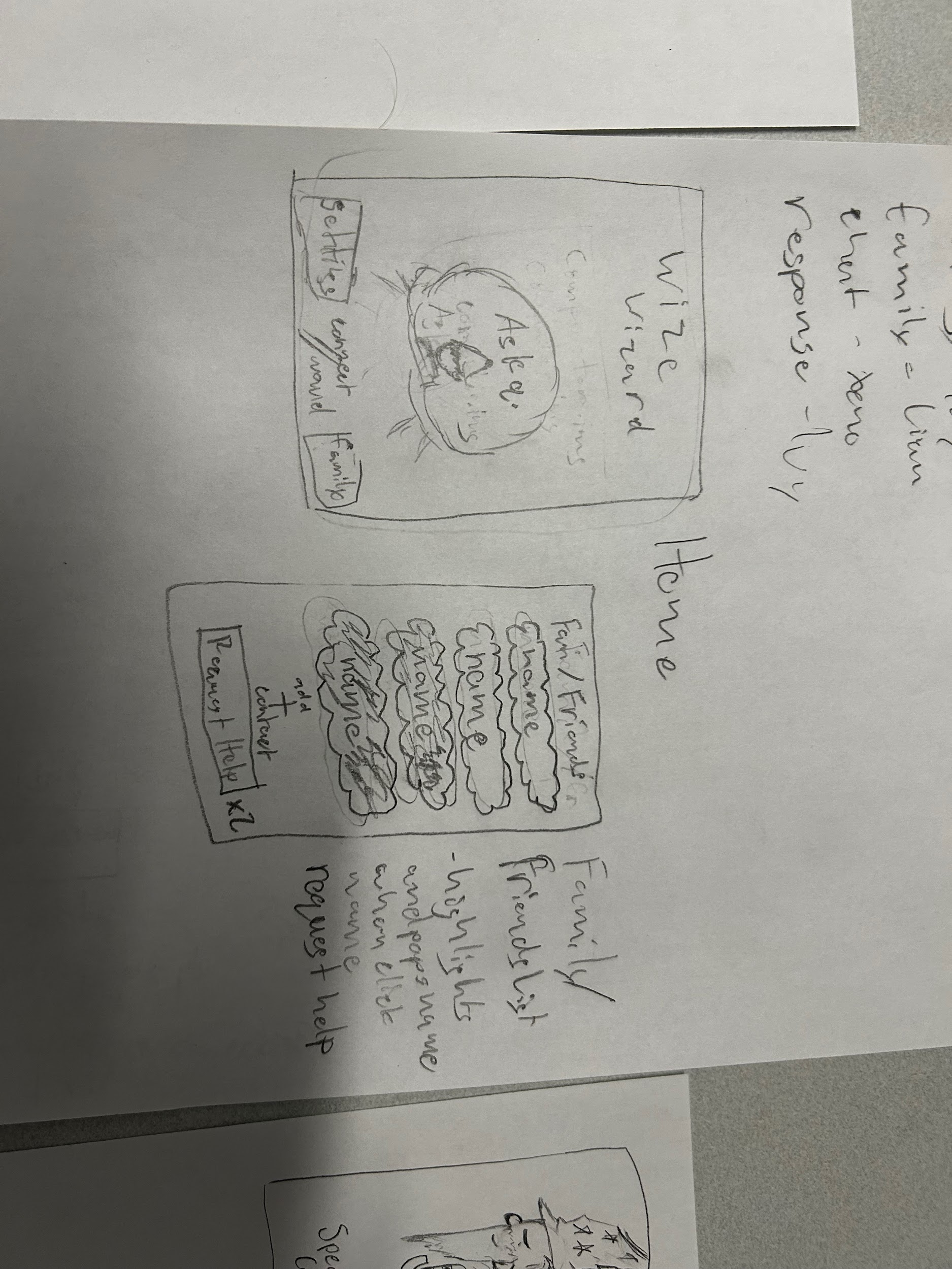
Design Evolution
Notes:
The transition from Lo-Fi to Hi-Fi was quite a simple process for our team,
we were able to translate and flesh out our ideas on paper to fully colored and functional versions!

Slide 6
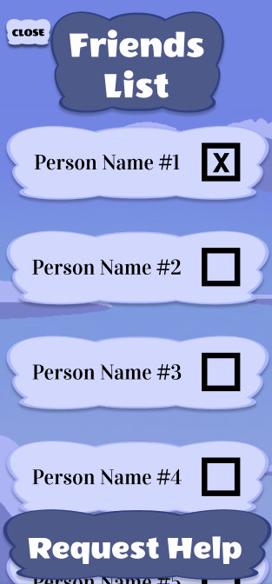
Improvements
Notes:
Thanks to some feedback from week 12B, we realized that our friends menu wasn’t as streamlined as we thought it would be,
so we made some changes from the Lo-Fi version, making it more clear that you could select a person to help you
by adding a box next to the person’s name that would be checked upon tapping, and then you would be able to tap the request help button which would show you the closest response they got from Wize Wizard!

Slide 7
Live Demo!
https://www.figma.com/proto/RSxgGK87Mfn7Zi3MMdL9PT/Wize-Wizard-Team-7-HiFi?node-id=1-3&p=f&t=BjF4dY05EDKZjwqI-1&scaling=scale-down&content-scaling=fixed&page-id=0%3A1&starting-point-node-id=1%3A3
Notes:
https://www.figma.com/design/RSxgGK87Mfn7Zi3MMdL9PT/Wize-Wizard-Team-7-HiFi?node-id=0-1&p=f&t=ZDLasnzMVwyvBzHa-0
startup : “Setting up usb”
2 flows:
Ask for restaurant
Request Help

Slide 8
Questions?
Notes:
Thank you for listening to our presentation, are there any questions?

